Slide 1


The New Generation of Targeted Attacks
Eric Chien
Sep 2010
Technical Director, Symantec Security Response
Notes:
Please see additional comments located in the notes section of each slide.

Slide 2
Targeted attacks are similar malicious threats sent to a narrow set of recipients based on their employment industry or direct involvement in an organization to gain access to intellectual property and confidential documents.
.

Slide 3
Agenda
1
Overview
A Closer Look
Defense
A Walk Through the Malware History
The Methodology of Targeted Attacks
Aurora (Hydraq)
Demonstration
Protection Challenges
Summary
Stuxnet
History of Targeted Attacks
2
3

Slide 4

History of Malware

Slide 5
First IBM PC virus:
Brain boot sector virus created in Pakistan
The Era of Discovery
1986
1987
1988
1989
1990
1991
First DOS File Infector:
Virdem presented at the Chaos Computer Club
First Polymorphic Virus:
Chameleon developed by Ralf Burger
Notes:
The Era of Discovery is when malware creators were attempting to create new and novel self-replicating code.

Slide 6
CIH:
A Windows file infector that would flash the BIOS
Michaelangelo trigger date: Causes widespread media panic that computers would be unbootable
The Era of Transition
1992
1993
1994
1995
1996
1997
1998
First Word Macro virus:
Concept is the first macro virus infected Microsoft Word documents
Notes:
The Era of Transition sees the rise of ‘script kiddies’ primarily fueled by Microsoft Office viruses written in a script language. Now less novel techniques are being discovered, but instead malware creators are doing it for fun, ushering in the next Era of Fame and Glory

Slide 7
Blended Threats:
CodeRed, Nimda spread without any user interaction using Microsoft system vulnerabilities
Worm wars:
MyDoom, Netsky, Sobig, all compete for machines to infect
Email systems down:
The Melissa worm spreads rapidly to computers via email causing networks to come to a crawl
The Era of Fame and Glory
1999
2000
2001
2002
2003
2004
2005
LoveLetter Worm:
First VBS script virus to spread rapidly via Outlook email
Samy My Hero:
XSS worm spreads on MySpace automatically friending a million users
Anna Kournikova:
Just another email worm, but successful in propagation using racy pictures of Anna Kournikova as bait
Notes:
The Era of Fame and Glory was a period when malware creators mostly created threats for bragging rights. Even though they “owned” potentially thousands of machines in a botnet, they did not monetize or necessarily ever do destructive actions with their botnet.

Slide 8
Rogue AV:
Becomes ubiquitous charging $50-$100 for fake proteciton
Mebroot:
MBR rootkit that steals user credentials and enables spamming
Hydraq:
Targets multiple US corporations in search of intellectual property
The Era of Mass Cybercrime
Stuxnet:
Targets industrial control systems in Iran
2006
2007
2008
2009
2010
Koobface:
Spreads via social networks and installs pay-per-install software
Zeus Bot:
Hackers botnet executable of choice -- steals online banking credentials
Storm Worm:
P2P Botnet for spamming and stealing user credentials
Conficker:
Spreads via MS08-067, builds millions-sized botnet to install pay-per-install software
Notes:
The current era is the Era of Mass CyberCrime where the vast majority of threats are written for monetary gain.
Hydraq and Stuxnet represent a different kind of CyberCrime, the beginnings of a new generation where they are targeted and really can be described more as CyberEspionage.

Slide 9
Solar Sunrise:
Attacks stealing passwords from DoD systems conducted by 2 Californian and 1 Israeli teenager
1998
1999
2000
2001
2002
Moonlight Maze:
Attacks targeting US military secrets reported to be conducted by Russia
Notes:
Targeted threats did not just start in 2009/2010, but have a history where mostly government organizations were affected

Slide 10
US Government:
Systems in the Department of Defense, State, Commerce, Energy, and NASA all comprised and terabytes of information confirmed stolen.
2003
2004
2005
2006
2007
Titan Rain:
Coordinated attacks on US government military installations and private contractors

Slide 11
Aurora (Hydraq):
Google announcesthey have been a victim of the Hydraq attacks
2008
2009
2010
2011
Ghostnet:
Attacks on Tibetan organizations and embassies of many EMEA countries, and NATO systems.
Stuxnet:
Malware discovered targeting Iran industrial control systems

Slide 12
US Government:
Systems in the Department of Defense, State, Commerce, Energy, and NASA all comprised and terabytes of information confirmed stolen.
2003
2004
2005
2006
2007
Titan Rain:
Coordinated attacks on US government military installations and private contractors

Slide 13
Solar Sunrise:
Attacks stealing passwords from DoD systems conducted by 2 Californian and 1 Israeli teenager
1998
1999
2000
2001
2002
Moonlight Maze:
Attacks targeting US military secrets reported to be conducted by Russia

Slide 14
US Government:
Systems in the Department of Defense, State, Commerce, Energy, and NASA all comprised and terabytes of information confirmed stolen.
2003
2004
2005
2006
2007
Titan Rain:
Coordinated attacks on US government military installations and private contractors

Slide 15
Aurora (Hydraq):
Google announcesthey have been a victim of the Hydraq attacks
2008
2009
2010
2011
Ghostnet:
Attacks on Tibetan organizations and embassies of many EMEA countries, and NATO systems.
Stuxnet:
Malware discovered targeting Iran industrial control systems
Notes:
The important take away from this timeline isn’t the few publically disclosed targeted attacks that have occurred over the years, but the many that likely have never been disclosed. Hydraq and Stuxnet represent a possible new generation of targeted attacks that have come to the forefront and are being acknowledge in the public.

Slide 16

Targeted Attack Methodology
Notes:
While all different, targeted attacks all have the same general methodology.

Slide 17



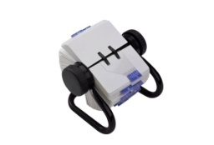
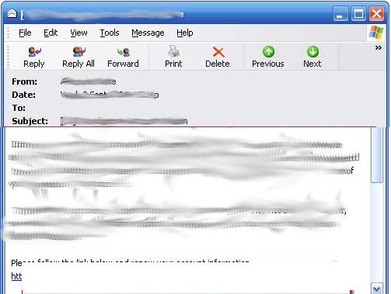


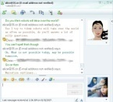




Targeted Attack Methodology
Social Engineering
Attacker
http://example.com/abc.html
Victim
Notes:
Attacker researches his target obtaining information such as their name, title, job position, interests, business interests, email, and other contact information
Attacker creates an email or IM that is carefully constructed to be of current interest to the intended target
For example, a key developer may have recently presented a research paper at a public conference. The attacker may send an email with a related research paper that has been modified to include an exploit.
For example, a corporation may be involved in public legal action, and their general counsel may be sent a link to a website supposedly containing information related to the legal action, but instead containing an exploit
The victim opens the mail, visits a link or opens an attachment that contains an exploit
Often, the victim may forward on the mail to others in the organization unknowingly exposing more people to the malicious code

Slide 18

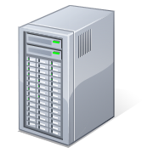











Targeted Attack Methodology
Payload Install and Execution
http://example.com/abc.html
Victim
Malicious Server
Backdoor Program
Malicious Server
Confidential Information
Attacker
Notes:
Once the victim opens a malicious attachment or visits a malicious link that leads to an exploit, his computer is compromised
The server typically delivers an executable that provides backdoor access to the attacker
The attacker now has full access to the victim’s machine and can steal confidential information and launch further attacks
Often intellectual property is targeted such as databases, email, design documents, and source code
The attacker has access to any resources the victim has access to
The attacker can use the victim’s machine to gain intelligence on further victims
The attacker may send additional malicious emails or IMs from the victim’s machine impersonating the victim

Slide 19
Targeted Attack Methodology
Mass Attacks vs. Targeted Attacks
Phase | Mass Attack | Targeted Attack
Incursion | Generic social engineering By-chance infection | Handcrafted and personalized methods of delivery
Discovery | Typically no discovery, assumes content is in a pre-defined and predictable location | Examination of the infected resource, monitoring of the user to determine additional accessible resources, and network enumeration
Capture | Pre-defined specific data or data that matches a pre-defined pattern such as a credit card number | Manual analysis and inspection of the data
Exfiltration | Information sent to a dump site often with little protection; dump site serves as long term storage | Information sent back directly to the attacker and not stored in a known location for an extended period
Notes:
Incursion – how the threat is installed on the system
Discovery – how the attacker finds resources of interest
Capture – how the attacker obtains confidential data
Exfiltration – how the attacker exports the data

Slide 20

A Closer Look at Hydraq

Slide 21
Timeline
Hydraq Attacks
April:
First confirmed attack related to December Hydraq attacks
June/July:
Attacks primarily using exploit PDFs deliver earlier variants of Hydraq
January 12:
Google announces they have been a victim of a targeted attack
2009 APR MAY JUN JUL AUG SEP OCT NOV DEC JAN 2010
Samples contain build times dating back to at least April 2007
August:
BugSec private reports IE vulnerability (CVE-2010-0249) to Microsoft, which is used in Dec attacks
Notes:
Key events for Hydraq attacks
Unconfirmed reports of Hydraq attacks date back to at least 2006.
Related attacks likely have occurred prior to even 2006, but currently have not been linked due to different binaries or methods of operation.

Slide 22
Timeline
December Hydraq Incident
January 15:
Exploit is made public and integrated into Metasploit
December 10:
More than 30 companies targeted by Hydraq attackers throughout December
January 12:
Google announces they have been a victim of a targeted attack
January 21:
Microsoft releases patches for CVE2010-0249
2009 DECEMBER JANUARY 2010
January 18:
Broad usage of CVE2010-0249 begins
January 14: Microsoft release Security Bulletin (979352) acknowledging CVE2010-0249
Notes:
Key events specifically surrounding the December Hydraq attacks.

Slide 23
Hydraq Attacks
Key Facts
More than 30 enterprises discover attacks in January 2010
Key personnel were targeted and sent information related to their business activities via email and instant messaging
A link was provided that led to an 0-day exploit targeting IE6
Other exploits (such as PDFs) had been used historically
The exploit silently downloaded and executed Trojan.Hydraq
Trojan.Hydraq allowed backdoor access to the infected machine
  Features are simple relative to other current threats
  Many code blocks appear to be copied from public sources
Attackers performed reconnaissance and obtained sensitive information from the infected machine and gained access to other resources on the network
Attacks were customized to each organization and specific details vary per targeted organization
Notes:
CVE2009-0249 / MS10-002
Allowed remote code execution via a specially crafted Web page
Other versions of IE were vulnerable, but only IE6 was targeted

Slide 24
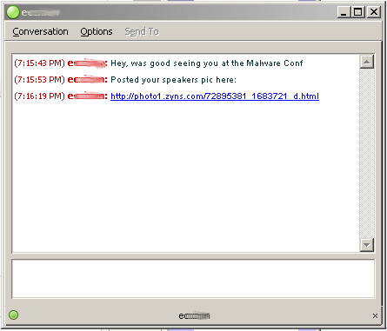
December Hydraq Incident
Personal Email or IM to the Victim
Attacker
Victim
Hi Eric,
I met you at the Malware Conference last month. Wanted to let you know I got this great shot of you doing your presentation. I posted it here:
http://photo1.zyns.com/72895381_1683721_d.html
Notes:
While the attack outlined here contains accurate data such as domains and filenames in a particular attack, each attack was customized to the victim and thus, characteristics may vary.
Attacker sent emails or IMs specially crafted for the victim that included a link to a fake photo site

Slide 25
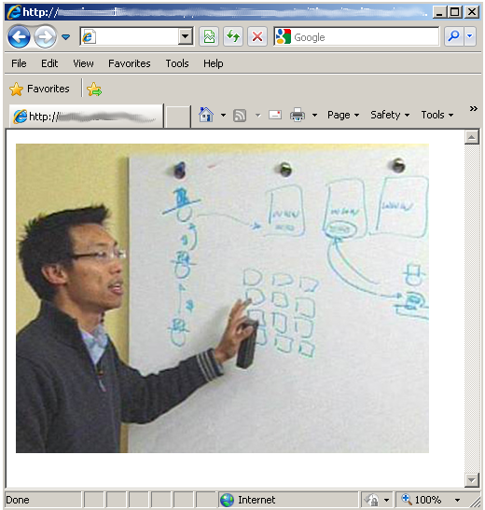
December Hydraq Incident
Bait Leads to 0-Day Exploit
Malicious server hosted by Chunghwa Telecom Co., Ltd. in Taiwan
Free dynamic DNS service provided by ChangeIP.com
Victim
PHOTO1.ZYNS.COM
203.69.40.144
Webpage with 0-day Exploit
Notes:
The fake photo site led to a dynamic DNS provider and eventually to a server in Taiwan
The server was hosting a webpage with a 0-day exploit (CVE-2009-249) specifically targeting Internet Explorer 6

Slide 26
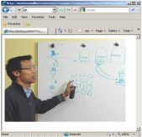
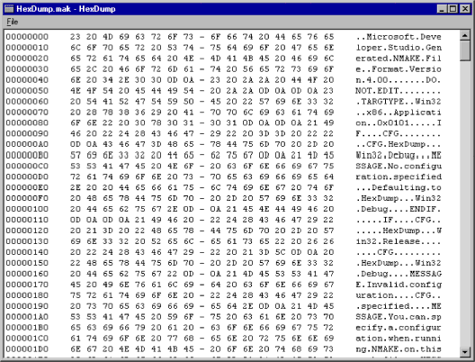

December Hydraq Incident
Exploit Downloads Dropper
Free dynamic DNS service provided by DynDNS
http://demo1.ftpaccess.cc/ad.jpg
Victim
FTPACCESS.CC
Hydraq Dropper
b.exe
a.exe
Decoded
XOR Encoded
Decoded by the shellcode and saved to %APPDATA%\b.exe
Saved to %APPDATA%\a.exe
Malicious server hosted by Chunghwa Telecom Co., Ltd. in Taiwan
Notes:
The exploit downloads an executable file from another server masked by a free dynamic DNS provider
The exe (Hydraq.Dropper) is decoded, saved, and executed by the exploit shellcode

Slide 27


December Hydraq Incident
Dropper Installs Hydraq Trojan
Hydraq Dropper
b.exe
Hydraq
Hydraq
Drops %system%\rasmon.dll
Victim
rasmon.dll
rasmon.dll
Hydraq
Adds itself as a service to the netsvc service group
rasmon.dll
svchost.exe
Hydraq
Drops a Windows logon password stealer
rasmon.dll
%TEMP%\1758.nls
Notes:
The Hydraq Dropper drops Hydraq as RASMON.DLL
Hydraq (rasmon.dll) is added as a service and executes under svchost.exe
Hydraq (rasmon.dll) also drops a Windows logon password stealer (1758.nls)

Slide 28

December Hydraq Incident
Hydraq Connects to Command & Control
Free dynamic DNS service provided by DynDNS
Hydraq
Connects to C&C server *.homelinux.org:443
(uses custom protocol – not HTTPS)
HOMELINUX.ORG:443
Victim
Attacker
72.3.224.71:443
Malicious server hosted by Rackspace, San Antonio
Notes:
Hydraq connects back to the attacker via another domain registered with a free dynamic DNS service
The attacker connects to the victim machine
The attacker steals intellectual property
The attacker launches further attacks such as sending emails or IMs to the victim’s contacts impersonating the victim

Slide 29
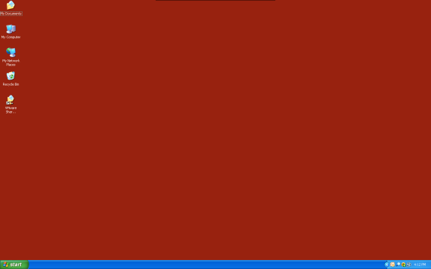
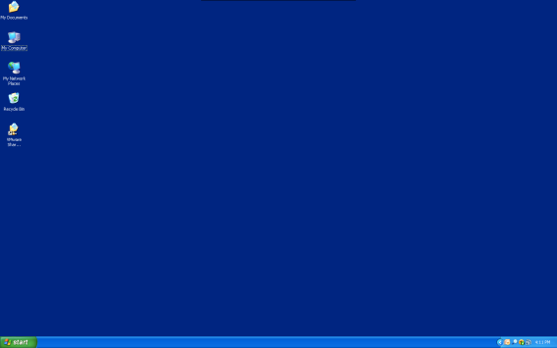

Demonstration
Overview
 Targeted socially engineered
attack begins, e.g., via email
Attacker
Victim unwittingly visits
malicious server
Victim
Malicious payload delivered,
VNC-like remote control
Attacker now has full access
to victims computer…
… and potentially every computer
connected to the victim

Slide 30

A Closer Look at Stuxnet

Slide 31
Stuxnet
Attacks industrial control systems
Spreads by copying itself to USB drives
  LNK vulnerability
  Autorun.inf
Spreads via network shares
Spreads using 2 known and 4 0-day Microsoft vulnerabilities
  MS08-067
  Default password in Siemens WinCC
  LNK: allows automatic spreading via USB keys
  Printer Spooler: allows network spreading to remote machines
  Undisclosed 1: local privilege escalation vulnerability
  Undisclosed 2: local privilege escalation vulnerability

Slide 32
Stuxnet
Uses a Windows rootkit to hide Windows binaries
  Signed by one of 2 stolen certificates from ‘JMicron’ and ‘Realtek’
Injects STL code into Siemens PLCs (Progammable Logic Controllers)
Uses rootkit techniques to hide injected PLC code
  Patches Siemens Step 7 software, which is used to view PLC code
Communicates with C&C servers using HTTP
  www.mypremierfutbol.com
  www.todaysfutbol.com
Steals designs documents for industrial control systems
Sabotages targeted industrial control systems
Targeted system likely in Iran

Slide 33


Stuxnet
Method of Delivery
Attacker
Victim
Employee
Co-workers
Notes:
The attack likely started with a USB key physically brought into the target environment via an insider or for example a USB key dropped in a parking lot.
That USB is shared or other USB keys plugged into infected machines become infected and are shared.
Stuxnet also spreads via the network via more traditional means and uses MS08-067 and the Printer Spooler vulnerability.

Slide 34
Stuxnet
ICS System Discovery
Attacker
http://<domain>/index.php?data=[DATA]
  www.mypremierfutbol.com
  www.todaysfutbol.com
http://<domain>/index.php?data=Step7_Installed
Notes:
Stuxnet contacts the C&C server and the attackers are in search of machines that can be used to program PLCs.
C&C traffic includes information on whether the machine has with Step7 or WinCC software installed.

Slide 35
Stuxnet
ICS Command & Control
Design Documents
  www.mypremierfutbol.com
  www.todaysfutbol.com
Commands to sabotage PLC
  www.mypremierfutbol.com
  www.todaysfutbol.com
Notes:
Attackers steal design documents and inject STL code into PLCs controlling automated systems such as pipelines or nuclear power plants.

Slide 36
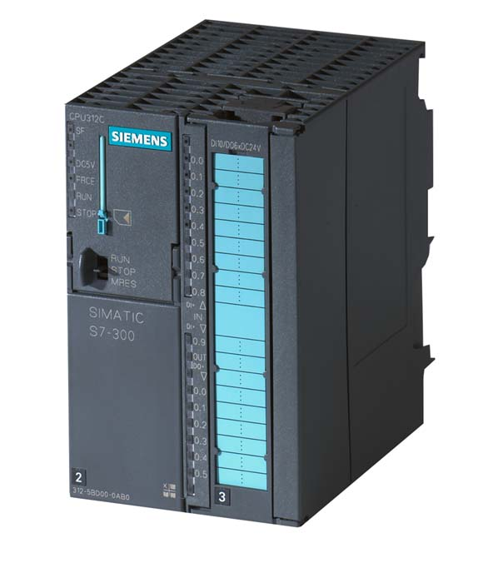
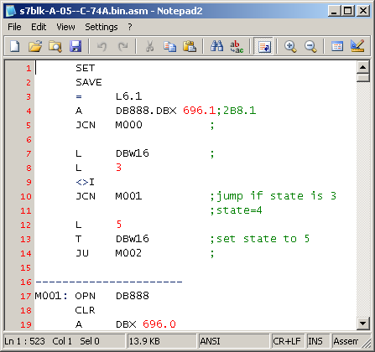
Stuxnet
Notes:
Screenshot of an S7-300 and STL source code injected by Stuxnet

Slide 37
Stuxnet
Over 40,000 infected unique external IPs, from over 115 countries
Notes:
Countries other than Iran are likely to be collateral damage

Slide 38
Stuxnet
Notes:
Countries other than Iran are likely to be collateral damage

Slide 39

Defense and Protection Challenges

Slide 40








Defenses
Email / IM Gateway
SPAM / Content Filtering
Attacker
Victim
Data Loss Prevention
Buffer Overflow /
Exploit protection
Behavior Blocking /
AV Scanning
IPS Protection/
URL Blocking
Reputation Scanning
Backdoor Program
Malicious Server
Notes:
This slide provides an example of layered defenses across the attack flow. While some of these defenses may fail, as long as a single defense succeeds, the overall attack is prevented.
The technologies illustrated in this slide may be utilized at multiple places in the attack flow, but are depicted in key locations for clarity.
This slide is not a comprehensive set of the possible defenses and does not include technologies that enforce policies and procedures or security-informed architecture.

Slide 41
Protection Challenges for Targeted Attacks
Technology | Effectiveness | Reason
Email/IM SPAM Filtering | Weak | Personalized emails to victims evade SPAM filters
Anti-virus signature scanning | Weak | Attackers can pre-scan executables with existing AV software, and modify until they are no longer detected Spaghetti code confuses heuristic scanning
Intrusion Prevention Systems | Moderate | Most 0-day attacks evade IPS scanners Protocol anomaly detection may have blocked post- infection communications
Browser Shield & Buffer Overflow Protection | High | Doesn’t require a-priori knowledge of the exploit Triggers on anomalies in execution path
URL Blocking / Content Filtering | Weak | Attacker-generated domains unknown to filter These domains are therefore typically allowed
File Reputation Scanning | High | Relies only on the community reputation of the file, which is typically low for personalized malware files
Behavior Blocking | High | Prevents malicious behaviors
Data Loss Prevention | Moderate | Network compromised, but sensitive data retained
Notes:
This slide is not a comprehensive set of the possible defenses and does not include technologies that enforce policies and procedures or security-informed architecture.

Slide 42
Summary
Targeted attacks similar to the Hydraq attacks have been occurring for at least a decade
The vast majority of attacks are never disclosed
Government entities, contractors, and large enterprises are the primary targets
Attacks are personalized to the victim
Attacks are often technically simple, but devastating in their payload
Targeted attacks will continue in the foreseeable future
Protection from targeted attacks requires vigilance as a breach only requires a single evasion

Slide 43
Questions?

Slide 44
Eric Chien
Technical Director
Symantec Security Response

Slide 45
Appendix
Notes:
Additional slides that were not presented due to time constraints

Slide 46


Internet Explorer Vulnerability

Slide 47


Internet Explorer Vulnerability
Vulnerability when Internet Explorer accesses an object that no longer exists
Exploit code is delivered via a specially crafted webpage
Allows remote code execution under the context of the logged-on user
Specifically targets Internet Explorer 6
Patches released on January 21, 2010 (CVE2009-0249 / MS10-002)
Exploit code leaks on to Internet on January 14, 2010
  Added to penetration test tools such as Metasploit
  Internet Explorer 6, 7, 8 all vulnerable
  Exploits now exist for 6, 7, and 8 bypassing built-in IE security (DEP/ASLR)
  Exploits do not bypass IE Protected Mode (IE7,8 on Vista/Win7)
    Secondary vulnerability can be exploited to bypass protected mode
  An additional 10 (7 in January, 3 in December) similar vulnerabilities have been disclosed and patched by Microsoft
  Symantec has seen relatively low usage (peak rate: 8,000 attacks a day)

Slide 48
Trojan.Hydraq
rasmon.dll

Slide 49
Trojan.Hydraq
Notable characteristics
rasmon.dll
Code is obfuscated using spaghetti code

Slide 50
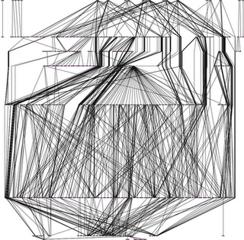
Trojan.Hydraq
Spaghetti Code
rasmon.dll
A
A
B
E
C
C
D
B
E
D
Notes:
Code of typical applications are laid out in a linear fashion
Spaghetti code chops the application into small blocks, rearranges blocks, and reconnects them with jumps
Graphing the blocks of the entire application results in a picture that looks like spaghetti making the application more difficult to analyze

Slide 51
Trojan.Hydraq
Notable characteristics
rasmon.dll
Code is obfuscated using spaghetti code
Stays resident by adding itself under the netsvc service group
  Running under svchost.exe
Drops a Windows logon password stealer that hides itself
Downloads a modified version of VNC remote control software
Instructed to download additional target-specific malicious components

Slide 52
Trojan.Hydraq
Network Communication
rasmon.dll
Contacts the command and control server over port 443.
  Traffic is not legitimate SSL traffic, but a custom protocol
Network traffic is trivially encoded
  Header data is XOR’d or NOT’d
  Data is XOR’d using a random key generated at runtime
Header data contains 23 hardcoded backdoor commands
  Read and write to the file system and registry
  Control processes
  Download and execute additional files
  Clear system logs
  Shutdown and restart the system
  Uninstall the threat

